Slide 1

GLOBAL CERT DATA SCIENCE INTERNSHIP TASK-1
WEEK-1 ANALYSIS ON E-COMMERCE RETAIL STORE CUSTOMER ATTRITION
Presented by:
TEAM-4

Slide 2

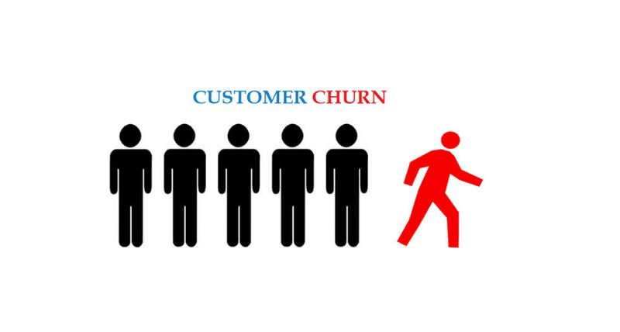
PROBLEM DEFINITION
In the vast world of marketing with a load of competition among the retail stores, an e-commerce retail store is facing customer attrition. After a careful study considering all the factors, reasons, and possibilities of the churn, we are required to build a model to analyze the rate of decreasing customers, tackle the declining rate, as well introduce ways to attract new customers by providing possible solutions.

Slide 3


CUSTOMER ATTRITION AND ITS MAJOR FACTORS
Customer attrition, often known as customer churn, refers to the loss of clients within a business. In basic terms, this is the point at when clients or consumers begin to distance themselves from an organization and discontinue their association with it.
MAJOR FACTORS
Poor customer service
Displeasing website interface
Product glitches
High pricing
Lack of quantity and quality
Delays
Poor marketing
Payment issues
and many more..

Slide 4
INSIGHTS DRAWN
Basic Insights
Country Insights
Cohort Insights
Items Insights
Revenue Insights
Stock Insights
Customer Insights
1
2
3
4
5
6
7

Slide 5
1. BASIC INSIGHTS
The total number of records were 541909 with null and repeating values
The total number of records were 541909 with null and repeating values
The total number of records were 541909 with null and repeating values

Slide 6
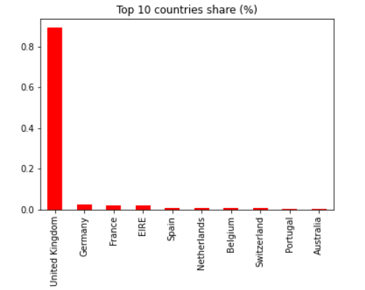
1. COUNTRY INSIGHTS
On processing the data, the unique countries were about 37+
Out of the 38 countries, United Kingdom has the highest share followed by Germany and the least was Hong Kong

Slide 7
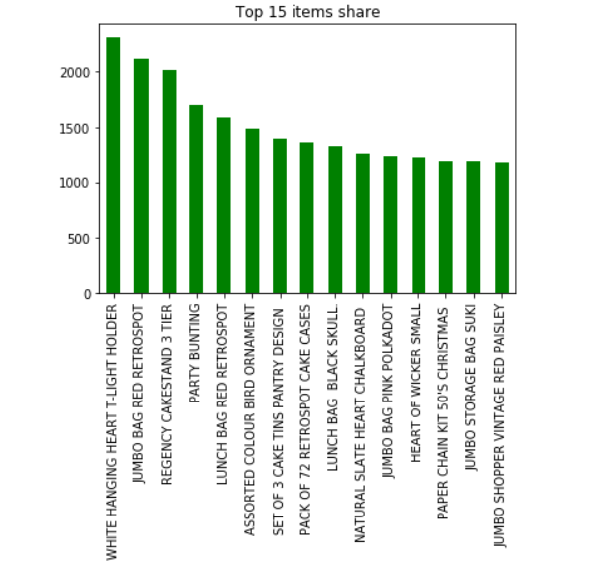
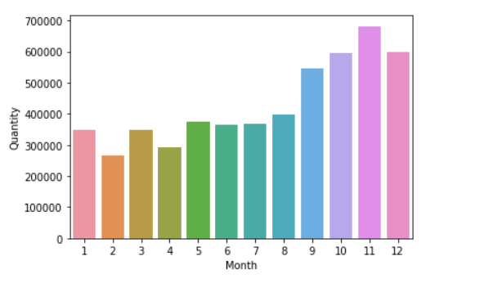
3. ITEMS INSIGHTS
The highest sold product is White Hanging Heart-T-Light Holder
The maximum month of sales was in November,2011 while the least was in February,2011

Slide 8
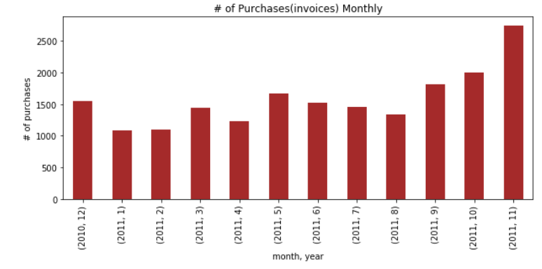
ITEMS INSIGHTS
No fixed pattern in the purchase of items per month
Maximum number of purchases was observed in November, 2011
The least was in February 2011

Slide 9
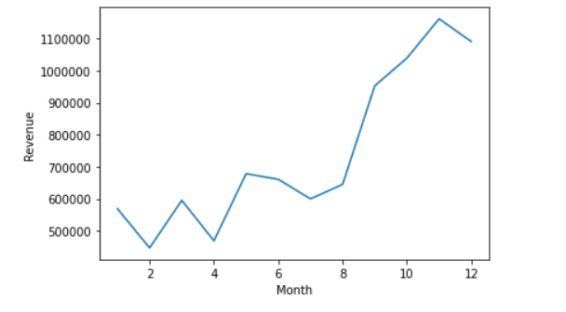
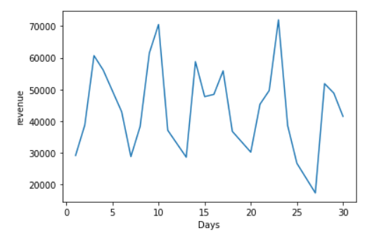
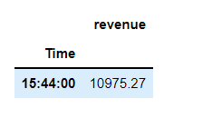
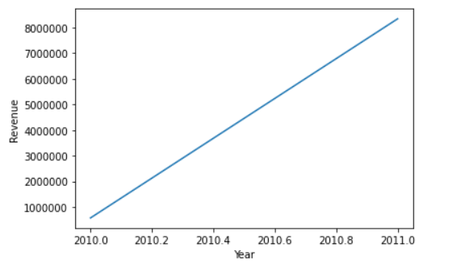
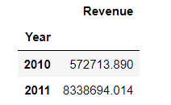
4. REVENUE INSIGHTS
Maximum revenue was on 23rd November 2011 at 3:44 pm
The revenue has significantly increased from 2010 to 2011

Slide 10
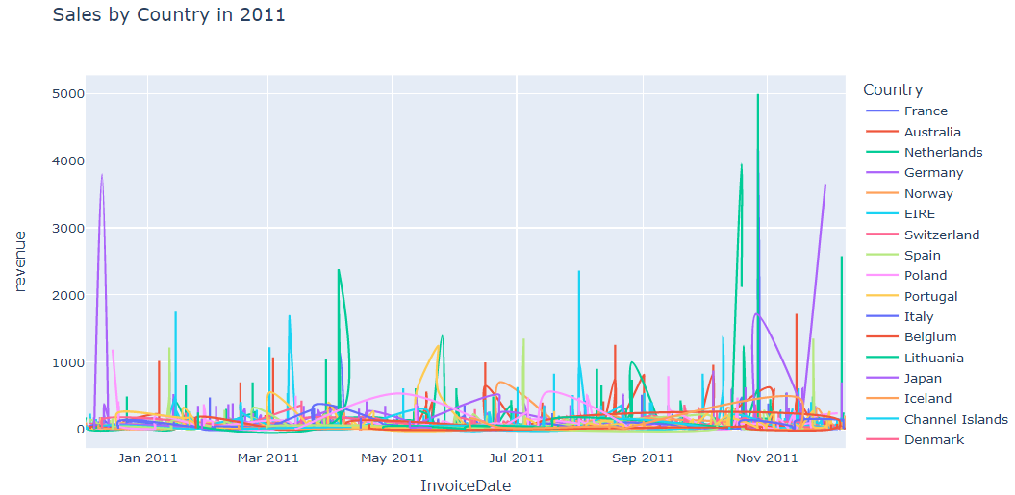
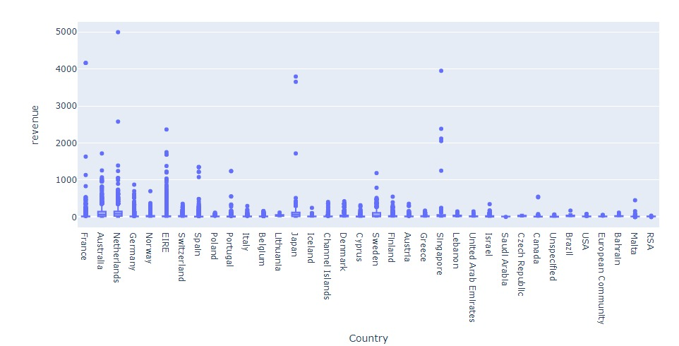
REVENUE INSIGHTS
The revenue generation with respect to the Invoice dates for all the countries is displayed with some being high and others minimal in the line plot
The difference in the revenue per country is evident in the box plot

Slide 11
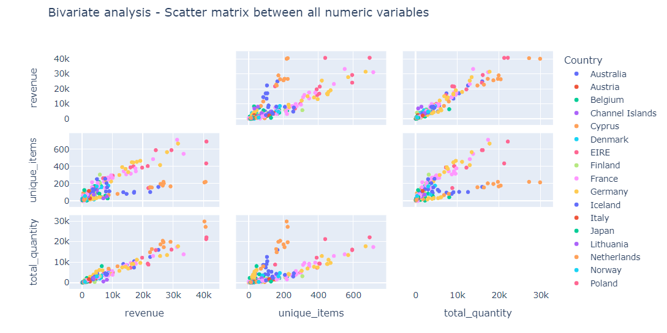
REVENUE INSIGHTS
The complete analysed graph of revenue, unique items and total quantity with all the combinations possible per country.
Clustered area depicting potential customer countries

Slide 12
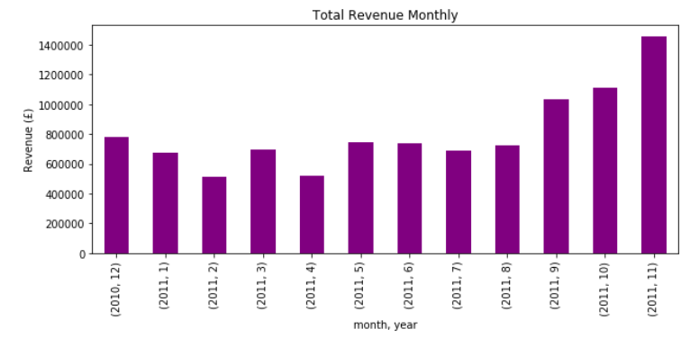
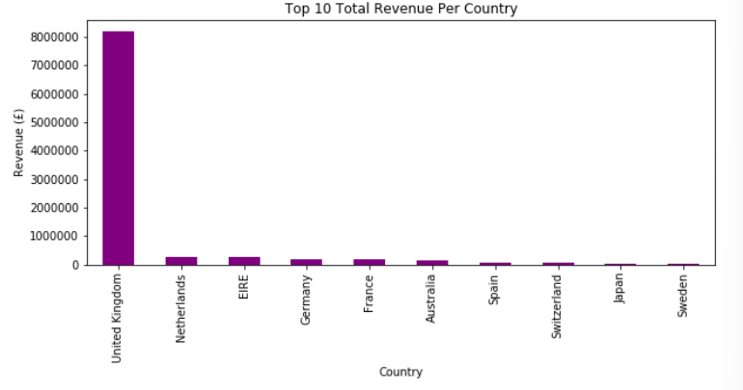
REVENUE INSIGHTS
Most revenue generated month was November with February being the least.
Average revenue months were Jan, March, May, June, July and August 2011.
Out of the top 10, maximum revenue by United Kingdom in 2011 while the least by Sweden

Slide 13
5. STOCK INSIGHTS
Maximum sold product stock code
“23843”
The revenue generated by it
168469.6
Minimum sold product stock code
“PADS”
The revenue generated
0.003

Slide 14
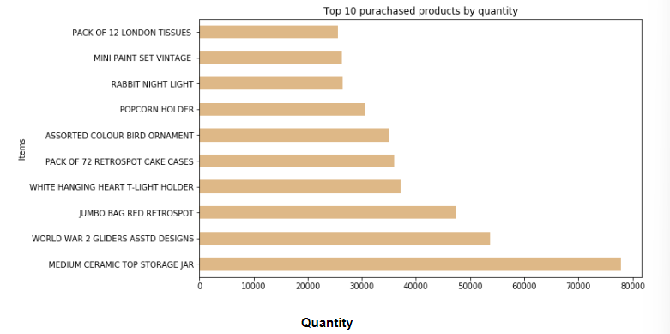
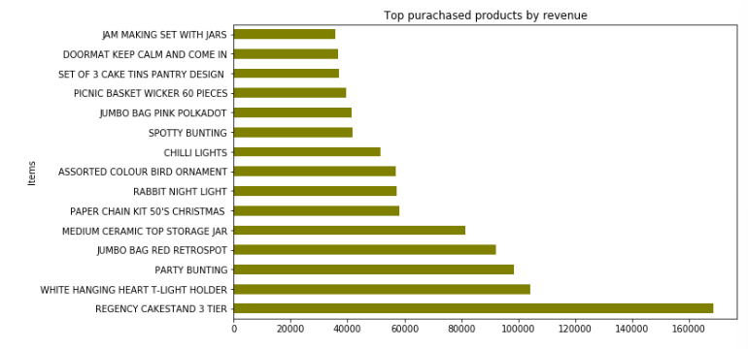
STOCK INSIGHTS
Medium Ceramic Top Storage Jar was the highest purchased product by quantity .
By revenue, Regency Cakestand 3 Tier was highest purchased.

Slide 15
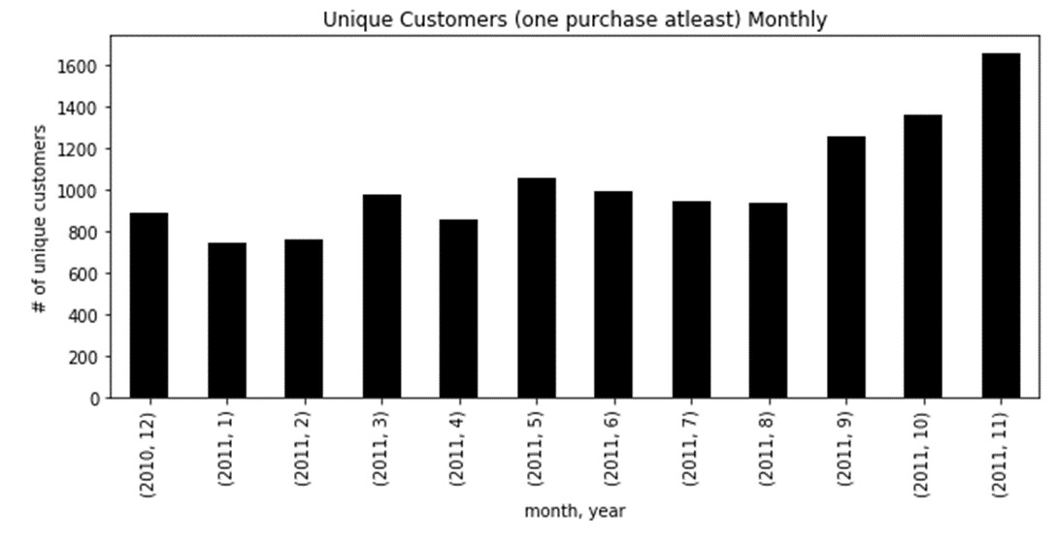
6. CUSTOMER INSIGHTS
Total number of customers per year
2010:
885
(only December)
2011:
4220
(all months)
The number of customers have significantly increased from 2010 to 2011.
November recorded the maximum number of unique customers along with January 2011 with the least.
2010 recorded unique customers only in the December

Slide 16
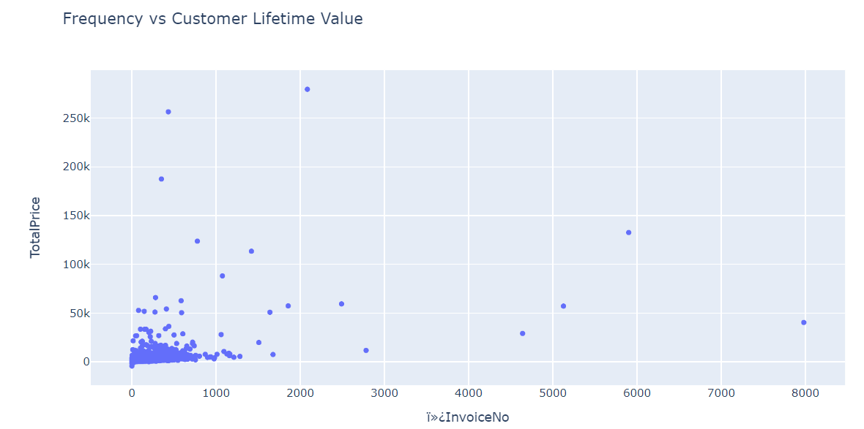
CUSTOMER INSIGHTS
The maximum customers with the invoice no in the range of 0-1000 are the most frequent customers
No customers with invoice no in the range 3000-4000 and 6000-7000
The remaining are less likely to revisit the site to shop

Slide 17
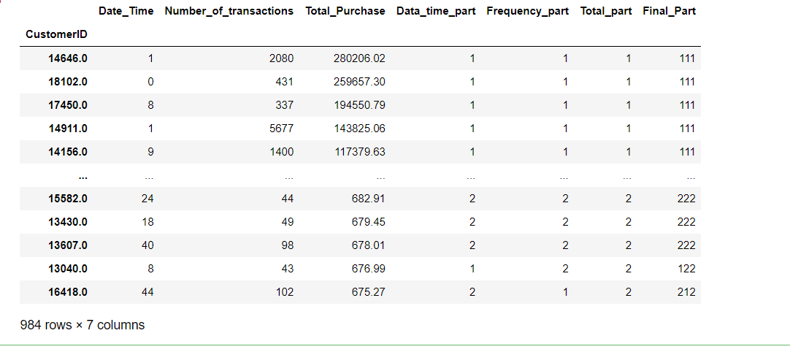
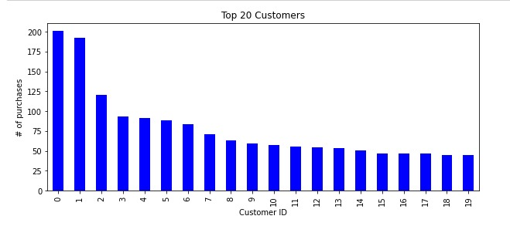
CUSTOMER INSIGHTS
Using RFM Analysis, 984 potential customers are recorded out of 541909 data values
Nan CustomerId has the maximum number of purchasee out of top 20 customers

Slide 18
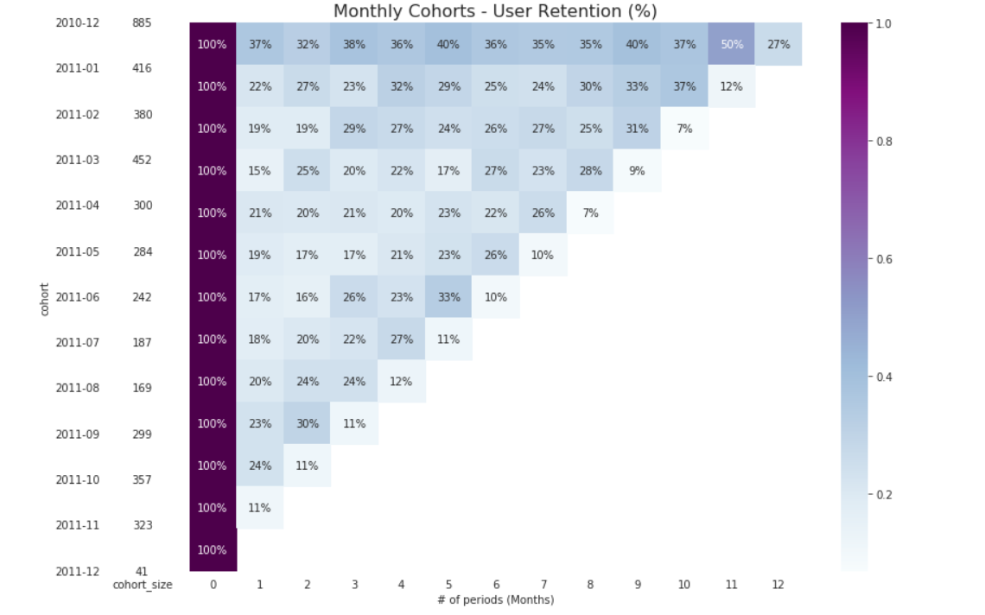
COHORT INSIGHTS
The first month is observed to have the best Cohort with a retention of 50%
On an average only 20% customers make another purchase in the second month
There is a common increase at the end of the year possibly because of vacations and festive seasons
The last drop in all cohorts is because the last period in the table is December 2011 having 9 days.

Slide 19



CONCLUSION AND SUGGESTIONS
Provide offers and discounts
Stock clearance sales
Similar products like the highest sold product
Provide personalized products
Promote Marketing
Tackle with lack of quantity and high pricing
Increase revisits by feedback system
Keep on updating the website
Keep a track of competitors
Focusing marketing campaigns in cohort period as customers are more open to spending during these times
Focusing on the first cohort by starting a "Loyalty Program" is recommended

Slide 20
THANK YOU !
- Team-4

